Slide 1
Basic Linux
Velocity Training Institute
Shantanu Mahajan (sr Engg Devops)

Slide 2
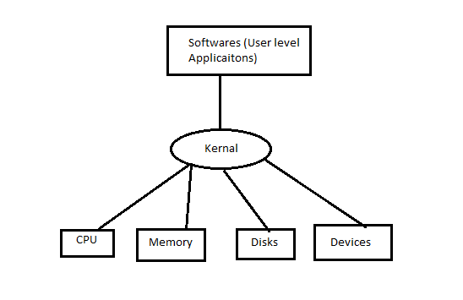
Introduction
Linux is a family of open-source Unix-like operating systems based on the Linux kernel, an operating system kernel first released on September 17, 1991, by Linus Torvalds.
The kernel is a computer program at the core of a computer's operating system and has complete control over everything in the system.

Slide 3
Linux vs windows
Linux
windows
Free source code i.e open source
Secure
Simplified update for all installed softwares
Light weight
Multiuser and multitasking is very easy
Multiple distributions/flavors are available
Source code is not free or open to all.
Not secure
Not light weight
Limitations to multitasking and multiuser management

Slide 4
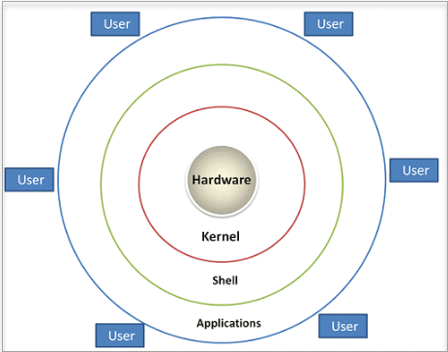
Architecture

Slide 5
shell
A Shell provides you with an interface to the Unix system. It gathers input from you and executes programs based on that input. When a program finishes executing, it displays that program's output.
Shell is an environment in which we can run our commands, programs, and shell scripts. There are different flavors of a shell, just as there are different flavors of operating systems. Each flavor of shell has its own set of recognized commands and functions
In simple terms SHELL is a program which provides the interface between the user and an operating system (os is also called as kernal)

Slide 6
Types of shell
The C shell (csh):- It includes helpful programming features like built-in arithmetic and C-like expression syntax.
The Bourne Shell (sh) :- It is the original UNIX shell. It is faster and more preferred. It lacks features for interactive use like the ability to recall previous commands. It also lacks built-in arithmetic and logical expression handling. It is default shell for Solaris OS.
The Korn Shell (ksh):- is a superset of the Bourne shell.So it supports everything in the Bourne shell.It has interactive features. It includes features like built-in arithmetic and C-like arrays, functions, and string-manipulation facilities.It is faster than C shell. It is compatible with script written for C shell.
Bourne Again Shell (bash) :- It is compatible to the Bourne shell. It includes features from Korn and Bourne shell.

Slide 7
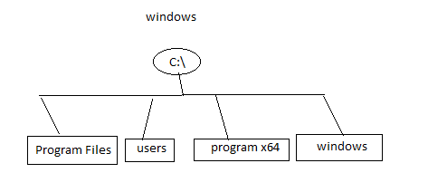
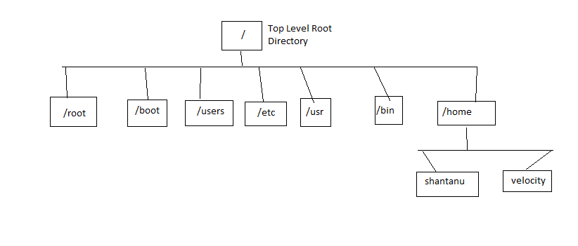
File system hierarchy
windows
Linux

Slide 8
Shell Scripting
The shell is a command line interpreter, it translates the user entered command and converts them into the language which is understood by the kernel.
Shell scripting is nothing but the list of commands which are listed in a script in the order of execution.
A good shell script will always have proper comments after every command.

Slide 9
Shell scripting
The comments should be given using the # sign.
The .sh at the end of the file tells us that it’s a shell script.
Eg:- devops.sh --- .sh indicated it’s a shell script
At the start of shell script its recommended to add the shebang (#! - shaa-bang) comment for the user to identify which shell is being used.
The operator #! known as the shebang operator is used to define the shell in which the script is going to run.
The Shebang for shell script is mostly not necessary when your code is independent of the type of shell, and would run on any type (bash, ksh, csh etc).
Eg:- #!/bin/sh --- for Bourne shell
#!/bin/bash -- for Bourne again shell. This indicates the path of the shell

Slide 10
Shell scripting
To execute the script we can use ./script-name.sh
Or else can do sh script-name.sh for Bourne shell
Or else bash script-name.sh for Bourne again shell execution.
This does not matter which shell you use sh or bash as for normal scripts it will have same output, this is needed when you want specific shell to run your script.

Slide 11
Variables
Variable is nothing but a character string to which we assign a value, or else we can say it’s a pointer to actual data.
The value can be a number, string, filename, device or any other type of data.
Types of variables
Local Variable
Environmental variable
Shell Variable

Slide 12
Local variable
A local variable is a variable which is present in the current instance of a shell script.
A variable declared as local is one that is visible only within the block of code in which it appears. It has local "scope". In a function, a local variable has meaning only within that function block.
Eg 1:- Func () {
NAME=SHANTANU # here the name variable is just limited to this particular function block but not in the program
}
Eg2-
If (int i=10;i<=5;i++) # here the value of i has a local scope just for this particular If condition

Slide 13
Environmental variable
The Environment Variables form a simple and effective way to pass information about the current operating environment to the program being executed.
Two common examples of Linux environment variables are the $PATH and $HOME variables.
We can set env variables using export command.
To simplify we can say that we can use the current shell variables in our script

Slide 14
SHELL variables
A shell variable is a special variable that is set by the shell and is required by the shell in order to functional correctly
A shell variable can be env. variable or a local variable.
A shell variable is created with the following syntax: "variable_name=variable_value”.

Slide 15
Special variables
Variable | Description
$0 | The filename of the current script.
$n | These variables correspond to the arguments with which a script was invoked. Here n is a positive decimal number corresponding to the position of an argument (the first argument is $1, the second argument is $2, and so on).
$$ | The process ID of the current shell. For shell scripts, this is the process ID under which they are executing.
$# | The number of arguments supplied to a script.
$@ | All arguments passed to script or function.|
$* | All arguments passed to script or function.|
$? | The exit status of the last command executed.
$! | The process ID of the last background command.
$_ | The last argument of the previous command.

Slide 16
Basic operators in shell
Arithmetic Operators
Relational operators
Boolean operators
String operators
File Test operators

Slide 17
Arithmetic Operators assuming a=10 and b=20
Operator | Description | Example
+ (Addition) | Adds values on either side of the operator | `expr $a + $b` will give 30
- (Subtraction) | Subtracts right hand operand from left hand operand | `expr $a - $b` will give -10
* (Multiplication) | Multiplies values on either side of the operator | `expr $a \* $b` will give 200
/ (Division) | Divides left hand operand by right hand operand | `expr $b / $a` will give 2
% (Modulus) | Divides left hand operand by right hand operand and returns remainder | `expr $b % $a` will give 0
= (Assignment) | Assigns right operand in left operand | a = $b would assign value of b into a
== (Equality) | Compares two numbers, if both are same then returns true. | [ $a == $b ] would return false.
!= (Not Equality) | Compares two numbers, if both are different then returns true. | [ $a != $b ] would return true.

Slide 18
Relational operators
Shell supports the following relational operators that are specific to numeric values. These operators do not work for string values unless their value is numeric.
For example, following operators will work to check a relation between 10 and 20 as well as in between "10" and "20" but not in between "ten" and "twenty".
Assume variable a holds 10 and variable b holds 20 then.
It is very important to understand that all the conditional expressions should be placed inside square braces with spaces around them. For example, [ $a <= $b ] is correct whereas, [$a <= $b] is incorrect.

Slide 19
Operator | Description | Example
-eq | Checks if the value of two operands are equal or not; if yes, then the condition becomes true. | [ $a -eq $b ] is not true.
-ne | Checks if the value of two operands are equal or not; if values are not equal, then the condition becomes true. | [ $a -ne $b ] is true.
-gt | Checks if the value of left operand is greater than the value of right operand; if yes, then the condition becomes true. | [ $a -gt $b ] is not true.
-lt | Checks if the value of left operand is less than the value of right operand; if yes, then the condition becomes true. | [ $a -lt $b ] is true.
-ge | Checks if the value of left operand is greater than or equal to the value of right operand; if yes, then the condition becomes true. | [ $a -ge $b ] is not true.
-le | Checks if the value of left operand is less than or equal to the value of right operand; if yes, then the condition becomes true. | [ $a -le $b ] is true.

Slide 20
Boolean Operators
Operator | Description | Example
! | This is logical negation. This inverts a true condition into false and vice versa. | [ ! false ] is true.
-o | This is logical OR. If one of the operands is true, then the condition becomes true. | [ $a -lt 20 -o $b -gt 100 ] is true.
-a | This is logical AND. If both the operands are true, then the condition becomes true otherwise false. | [ $a -lt 20 -a $b -gt 100 ] is false.

Slide 21
String Operators
Assume variable a holds "abc" and variable b holds "efg" then
Operator | Description | Example
= | Checks if the value of two operands are equal or not; if yes, then the condition becomes true. | [ $a = $b ] is not true.
!= | Checks if the value of two operands are equal or not; if values are not equal then the condition becomes true. | [ $a != $b ] is true.
-z | Checks if the given string operand size is zero; if it is zero length, then it returns true. | [ -z $a ] is not true.
-n | Checks if the given string operand size is non-zero; if it is nonzero length, then it returns true. | [ -n $a ] is not false.
str | Checks if str is not the empty string; if it is empty, then it returns false. | [ $a ] is not false.

Slide 22
File test Operator
Assume a variable file holds an existing file name "test" the size of which is 100 bytes and has read, write and execute permission on −
-r file | Checks if file is readable; if yes, then the condition becomes true. | [ -r $file ] is true.
-w file | Checks if file is writable; if yes, then the condition becomes true. | [ -w $file ] is true.
-x file | Checks if file is executable; if yes, then the condition becomes true. | [ -x $file ] is true.
-s file | Checks if file has size greater than 0; if yes, then condition becomes true. | [ -s $file ] is true.

Slide 23
Operator | Description | Example
-b file | Checks if file is a block special file; if yes, then the condition becomes true. | [ -b $file ] is false.
-c file | Checks if file is a character special file; if yes, then the condition becomes true. | [ -c $file ] is false.
-d file | Checks if file is a directory; if yes, then the condition becomes true. | [ -d $file ] is not true.
-f file | Checks if file is an ordinary file as opposed to a directory or special file; if yes, then the condition becomes true. | [ -f $file ] is true.
-g file | Checks if file has its set group ID (SGID) bit set; if yes, then the condition becomes true. | [ -g $file ] is false.
-k file | Checks if file has its sticky bit set; if yes, then the condition becomes true. | [ -k $file ] is false.
-p file | Checks if file is a named pipe; if yes, then the condition becomes true. | [ -p $file ] is false.
-t file | Checks if file descriptor is open and associated with a terminal; if yes, then the condition becomes true. | [ -t $file ] is false.
-u file | Checks if file has its Set User ID (SUID) bit set; if yes, then the condition becomes true. | [ -u $file ] is false.
-r file | Checks if file is readable; if yes, then the condition becomes true. | [ -r $file ] is true.
-w file | Checks if file is writable; if yes, then the condition becomes true. | [ -w $file ] is true.
-x file | Checks if file is executable; if yes, then the condition becomes true. | [ -x $file ] is true.
-s file | Checks if file has size greater than 0; if yes, then condition becomes true. | [ -s $file ] is true.
-e file | Checks if file exists; is true even if file is a directory but exists. | [ -e $file ] is true.

Slide 24
Decision making using If-else
The if...else statements
If else statements are useful decision-making statements which can be used to select an option from a given set of options.
Unix Shell supports following forms of if…else statement −
if...fi statement
if...else...fi statement
if...elif...else...fi statement

Slide 25
Decision making
Syntax for If.
# If [expression]
then
Statements to be executed
fi
Syntax for if else.
# if [expression/condition]
then Statements to be executed when condition true
else
Statements to be executed when condition not true
fi

Slide 26
If-elif-fi
if [ expression 1 ]
then
Statement(s) to be executed if expression 1 is true
elif [ expression 2 ]
then
Statement(s) to be executed if expression 2 is true
elif [ expression 3 ]
then
Statement(s) to be executed if expression 3 is true
else
Statement(s) to be executed if no expression is true
fi

Slide 27
Shell loops
While loop
For loop
Until loop
Nested loop
Infinity loop
Loop control

Slide 28
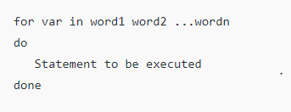
For loop
The for loop operate on lists of items. It repeats a set of commands for every item in a list.
Here var is the name of a variable and word1 to wordN are sequences of characters separated by spaces (words). Each time the for loop executes, the value of the variable var is set to the next word in the list of words, word1 to wordN.

Slide 29
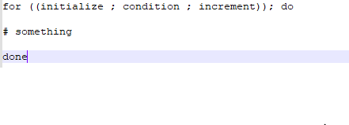
For loop

Slide 30
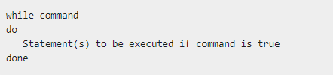
While loop
While loop enables you to execute the set of commands repeatedly whenever the condition is true
i.e whenever the condition we set is true the loop will be executed.

Slide 31
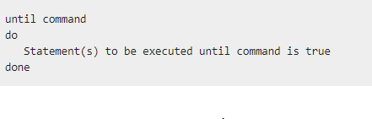
Until loop
Sometimes we need to execute the set of commands until a condition is true
In simple words, here if the condition is false, then the given statement is executed.

Slide 32
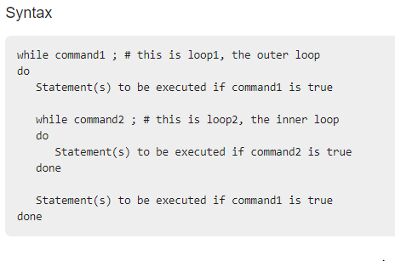
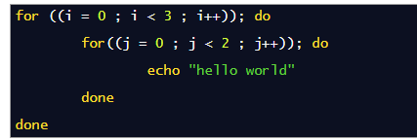
Nested loop
Here we can put one loop inside the another.

Slide 33
Loop Control
The Break Statement:-
The break statement is used to terminate the execution of the entire loop, after completing the execution of all of the lines of code up to the break statement. It then steps down to the code following the end of the loop.
The Continue Statement
The continue statement is similar to the break command, except that it causes the current iteration of the loop to exit, rather than the entire loop.
This statement is useful when an error has occurred but you want to try to execute the next iteration of the loop.

Slide 34

Functions
Functions enable you to break down the overall functionality of a script into smaller, logical subsections, which can then be called upon to perform their individual tasks when needed.

Slide 35
Return value from function
Based on the situation you can return any value from your function using the return command whose syntax is as follows −
return code
Here code can be anything you choose here, but obviously you should choose something that is meaningful or useful in the context of your script as a whole.

